Slide 1
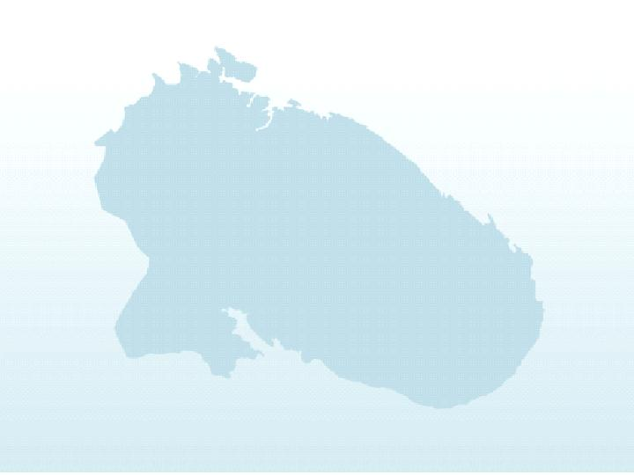
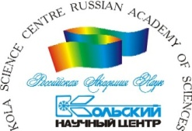
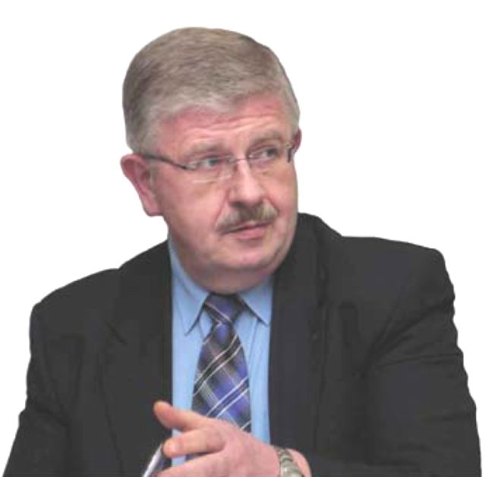
International Co-operation and Safety of Arctic Environment
Prof. Vladimir Masloboev
Kola Science Center
Russian Academy of Sciences

Slide 2
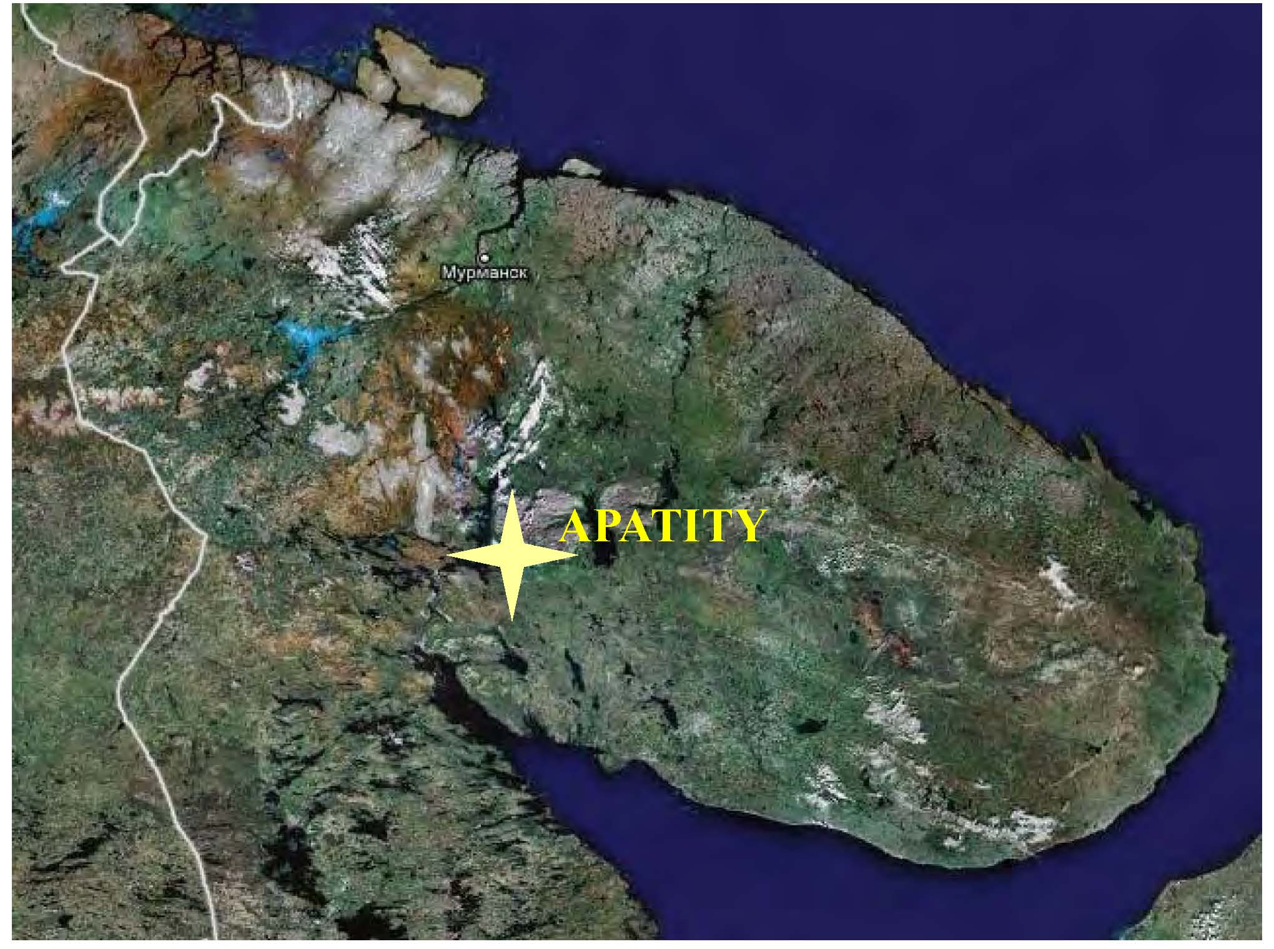

Slide 3
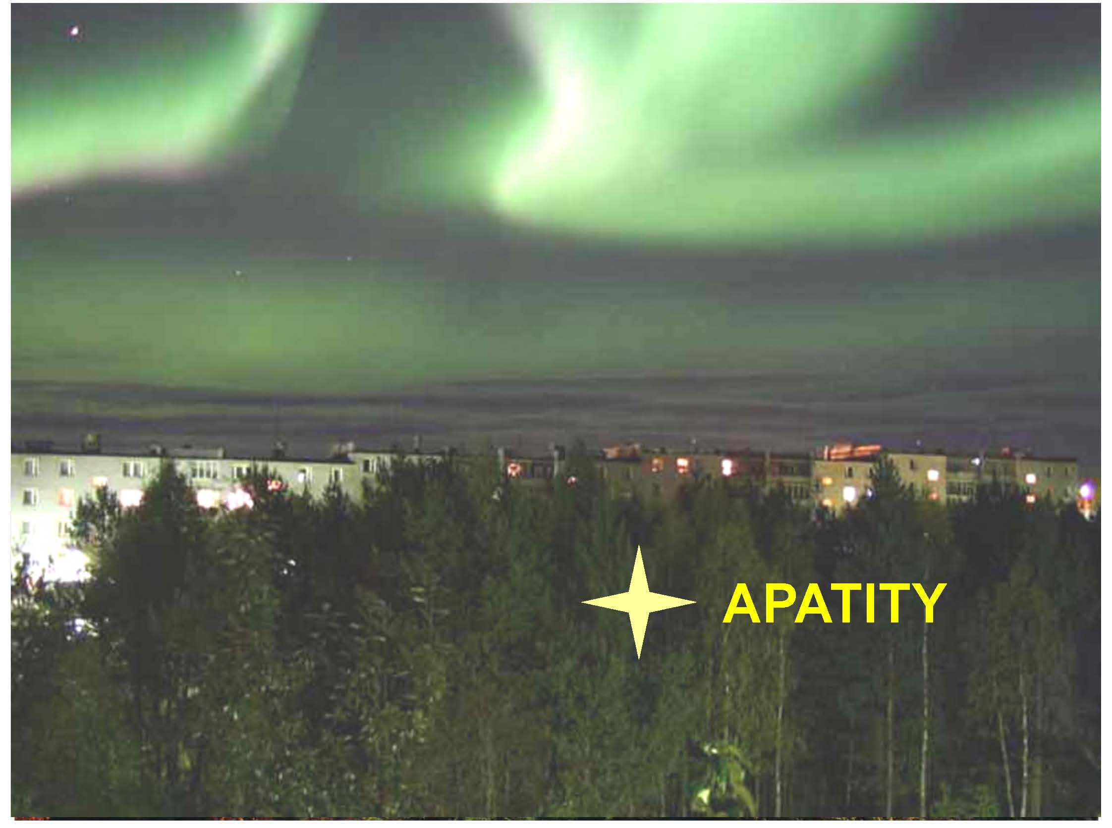

Slide 6
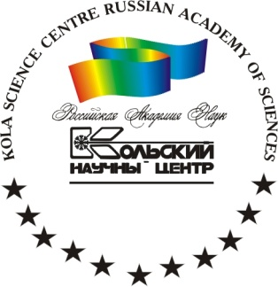
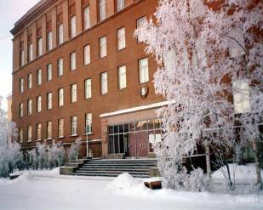
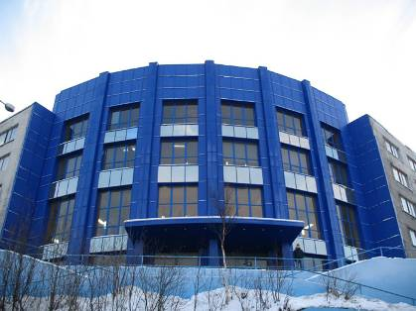
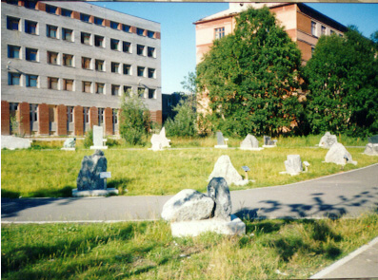
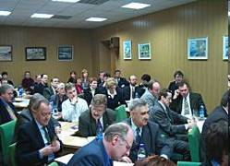
SCIENTIFIC, TECHNICAL AND INNOVATION COMPLEX
Number of Workers in the Field of Research and Development are 2102 persons (on the beginning of 2008). Number of Post-Graduate Students are 534 persons.
In the Kola Science Center of RAS there are 11 Research Institutes from whish 9 are located in Apatity City.
Total Number of Workers at Kola Science Center are 1547 persons
In 2007 the Financing Volume of Scientific and Technical Works has made 1,8 billion RBL, including at the Kola Science Center of RAS - 0,8 billion rbl.
Number of the Enterprises used the Advanced Industrial Technologies (Innovations): 2005 - 209, 2007 - 223.

Slide 8
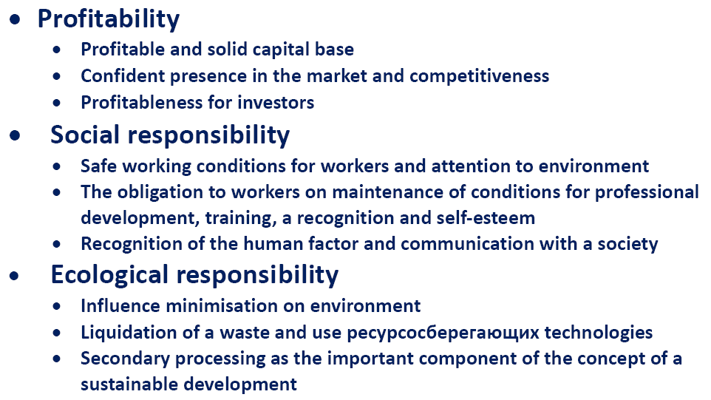
Three pillars of sustainable
development in Arctic

Slide 9
The main goals in the sustainable management of the natural resources using in Arctic regions are: Non-depletable use renewable and rational development of not renewable natural resources; Protection the environment from pollution; Preservation and rehabilitation of the landscape and biological diversity, sufficient for maintenance of ability of natural ecosystems to self-regulation and compensation of consequences of anthropogenous activity; Adaptation to global climate changes in Arctic regions.
7

Slide 11
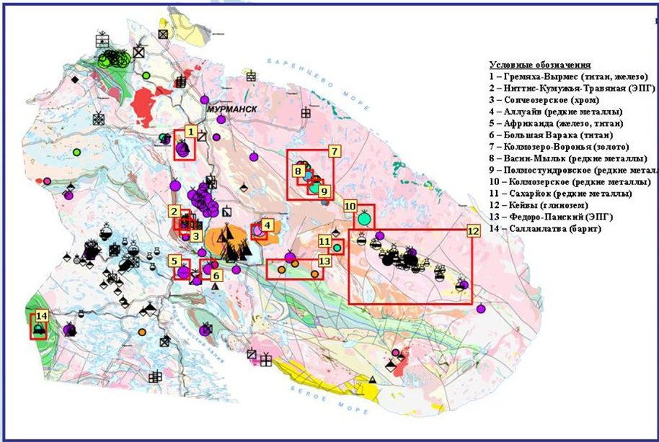
Perspective deposits of Kola peninsula

Slide 15
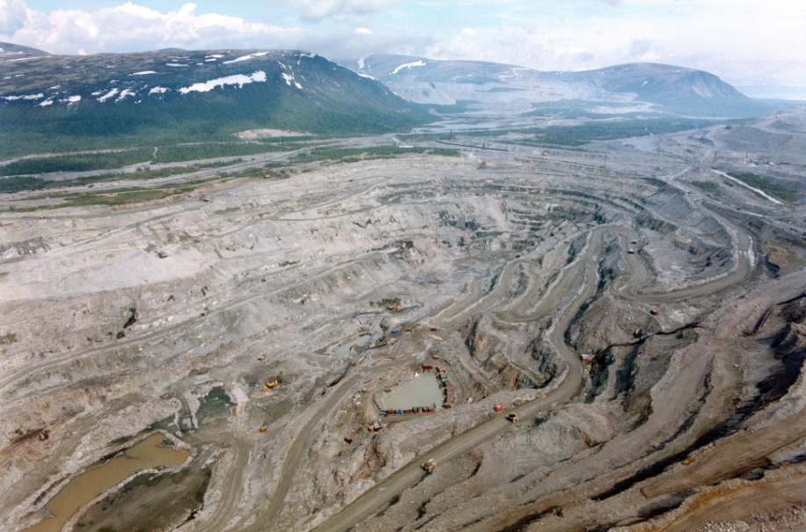
Green Mining can be considered as any modern mining exercise where the mineral resource depletion would be simultaneously compensated by growth and restoration of natural capital of water resource, land, plants and trees, biodiversity as well as possibilities of resuming alternative economic uses like tourism and agriculture.

Slide 16
By the mining enterprises of Kola peninsula it is annually made to 200 million tons of a solid waste and it is consumed up to 2 billion cubic meter of fresh water. Recycling of concentrators tailings and mine dump waste does not exceed 3-4% from the excavated ore volume . In mine dumps and tailing storages it is saved up more than 6 billion tons of the crushed and disintegrated rocks.
SCALES OF TECHNOGENIC LOADING
ON KOLA PENINSULA

Slide 17
MAIN GOAL FOR GREEN MINING ON KOLA PENINSULA IS: “To convert a waste product into a co-product adding enough value to generate positive economics while concurrently preserving the environment.”
New Project: “Sustainable Mining, Local Communities and Environmental Regulation in Kolarctic Area (SUMILCERE)

Slide 18
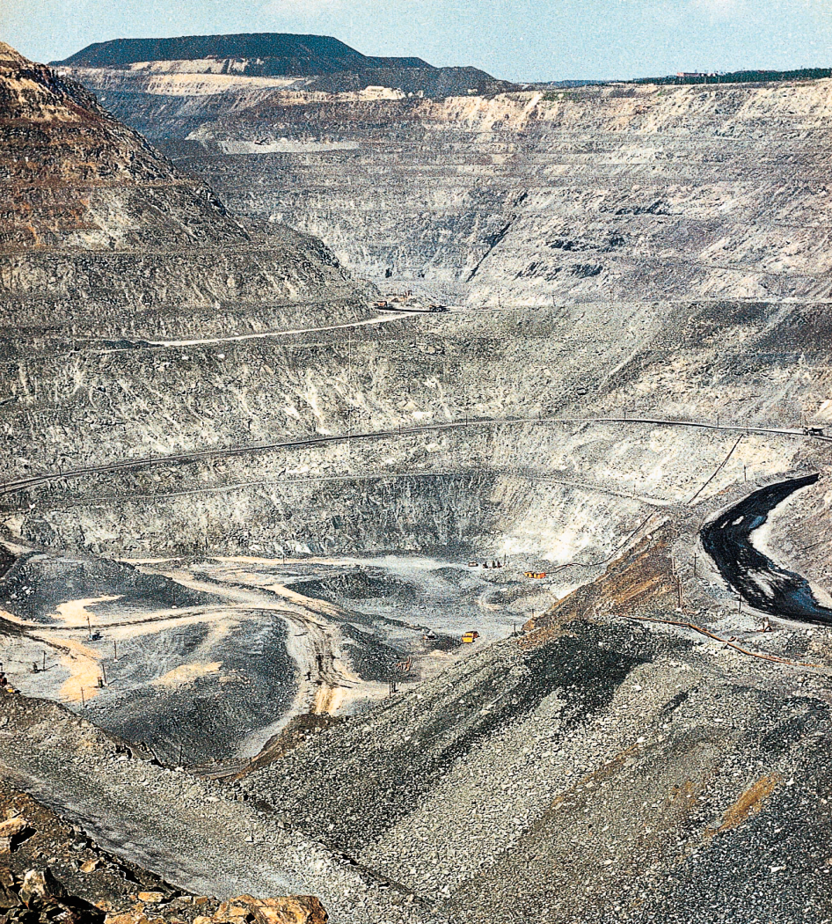
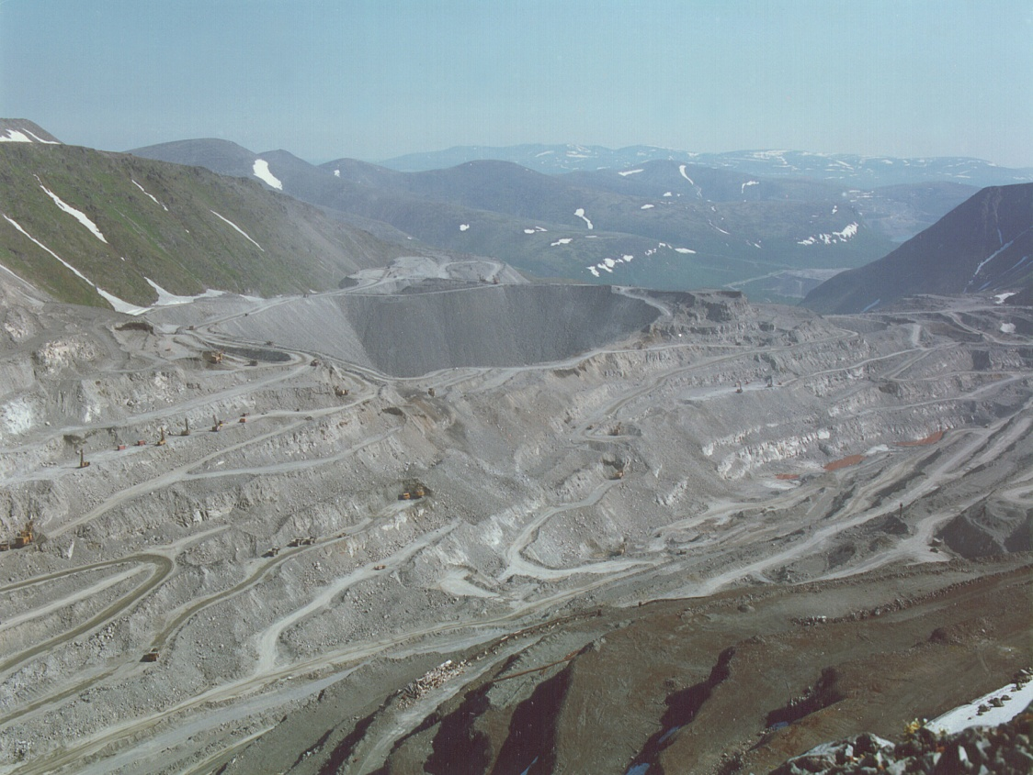
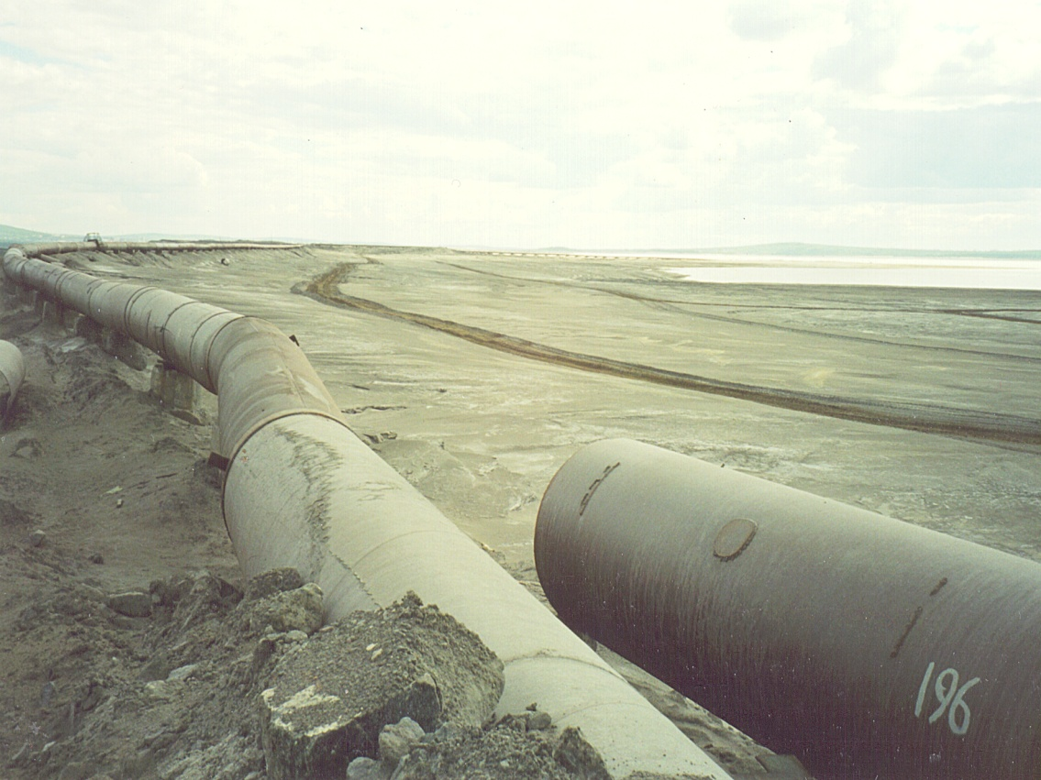
Green Mining Technologies must to be developed that helps in reducing or eliminating the negative environmental impact of past mining practices.

Slide 19
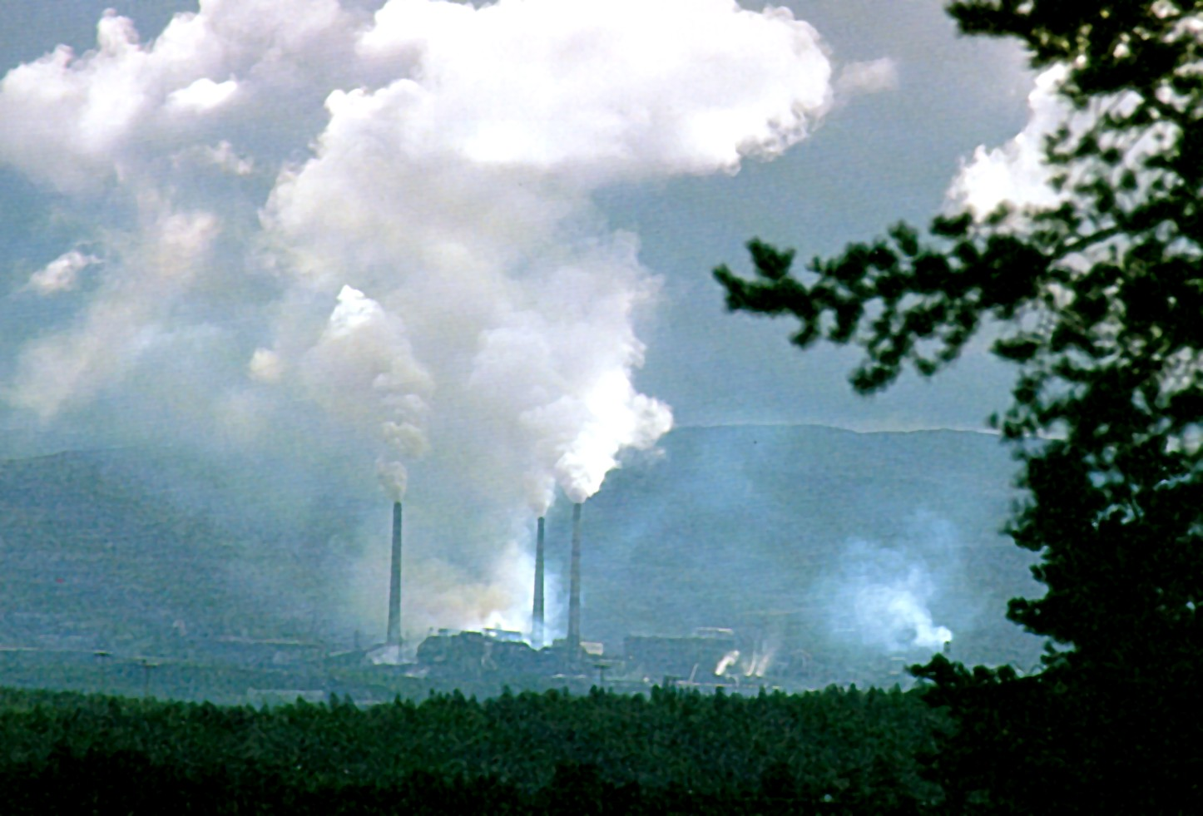
Cu-Ni SMELTERS - THE MAIN
POLLUTION SOURCES IN THE KOLA

Slide 20
The main sources of contamination of waters and terrestrial ecosystems on Kola Peninsula: 1. Airborne contamination of watersheds by emissions of sulphur dioxide and heavy metals from enterprises of non-ferrous industry and from coal- and heavy oil power and heating stations; 2. Sewage waters disposal from mining and metallurgical enterprises into environment; 3. Leaching of pollutants (heavy metals, radionuclides, fluor, etc.) from crushed rocks storages, tailing dumps of mining and metallurgical enterprises; 4. Geochemical cycles under affecting of acidic precipitations; 5. Transboundary transport of pollutants.

Slide 21
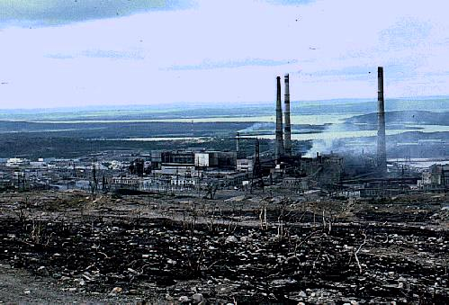
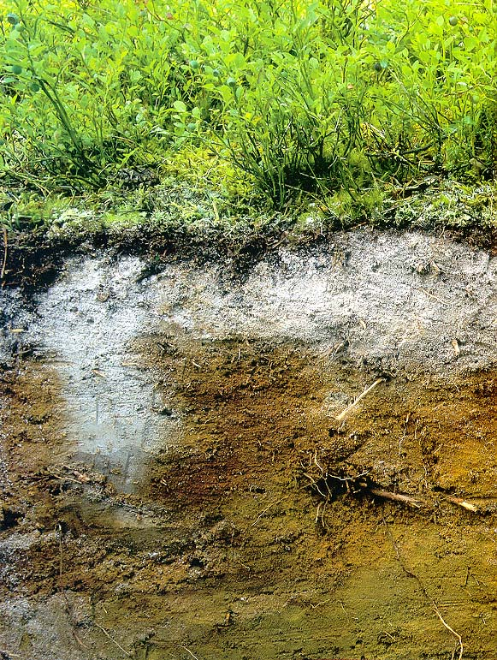
H⁺
Ni²⁺
Cu²⁺
Ca²⁺ Mg²⁺
Mn²⁺
Zn²⁺
Depletion in nutrients of the organic horizon

Slide 22
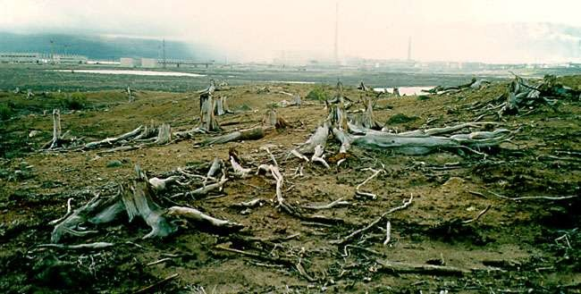
Industrial Barren in Vicinity of Severonickel Smelter, Monchegorsk City (15 years ago)

Slide 23
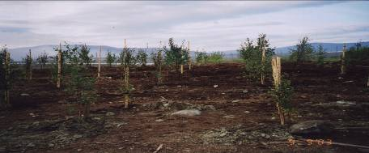
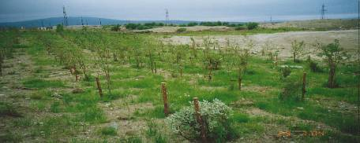
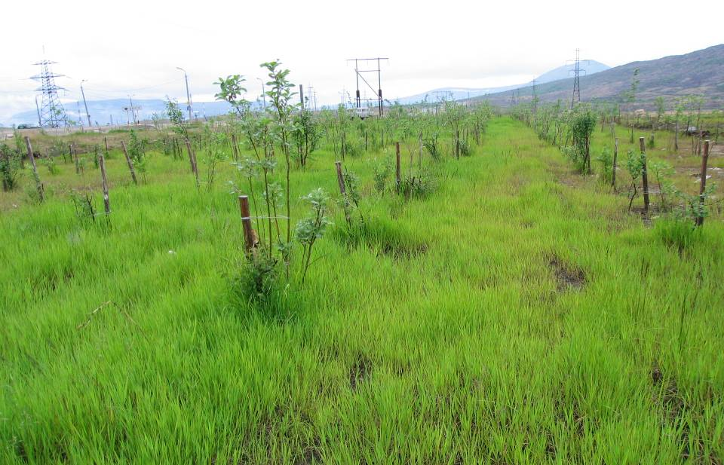
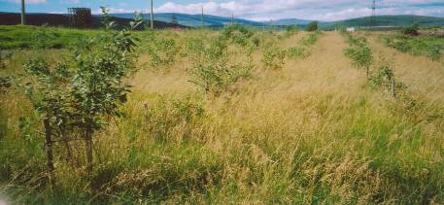
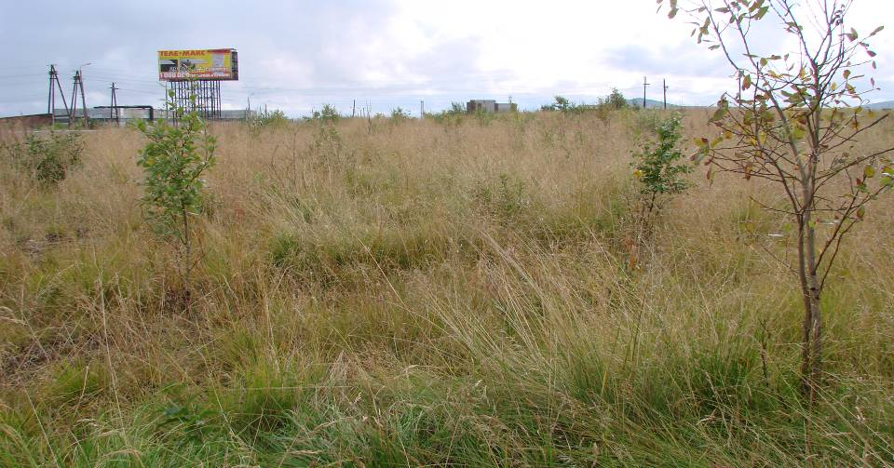
Monchegorsk / Мончегорск
2003
2004
2005
2006
2008

Slide 24
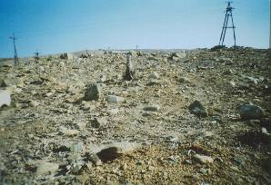
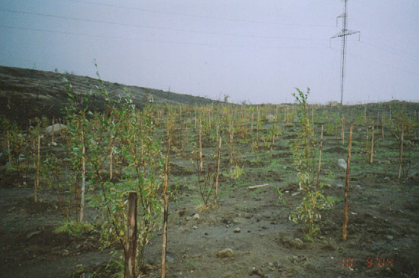
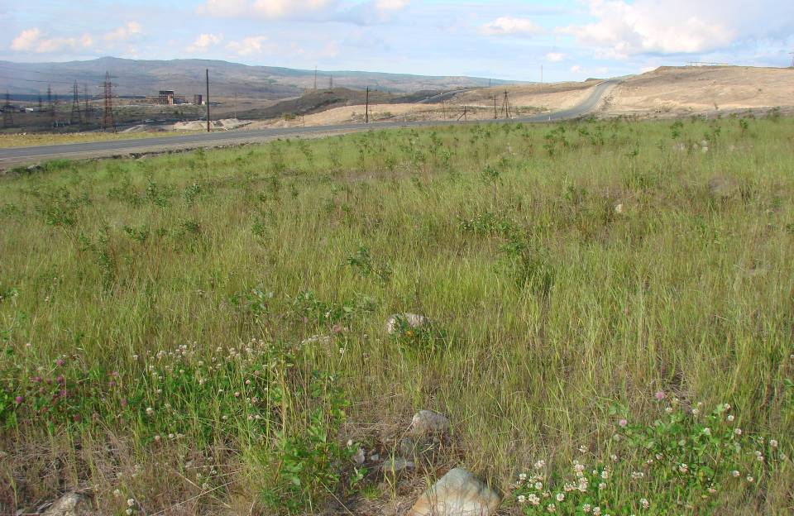
2003 Nickel, Zapolyarny / Никель, Заполярный
2004
2007

Slide 26
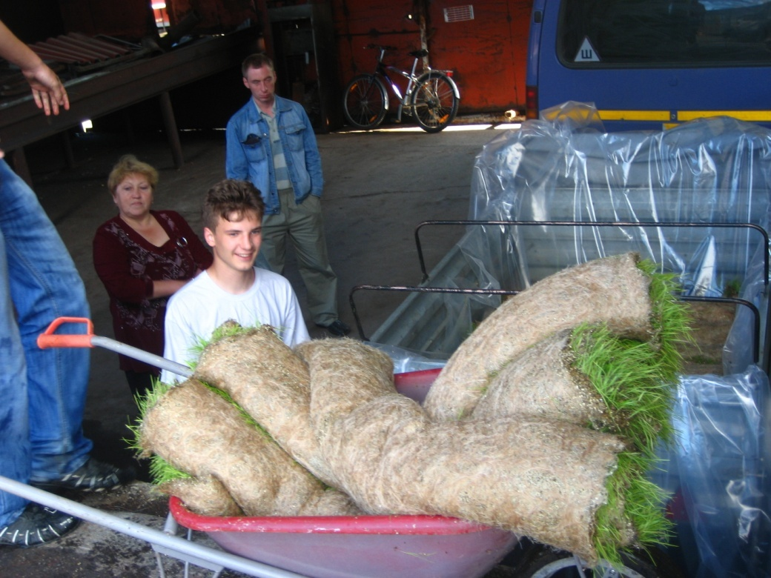
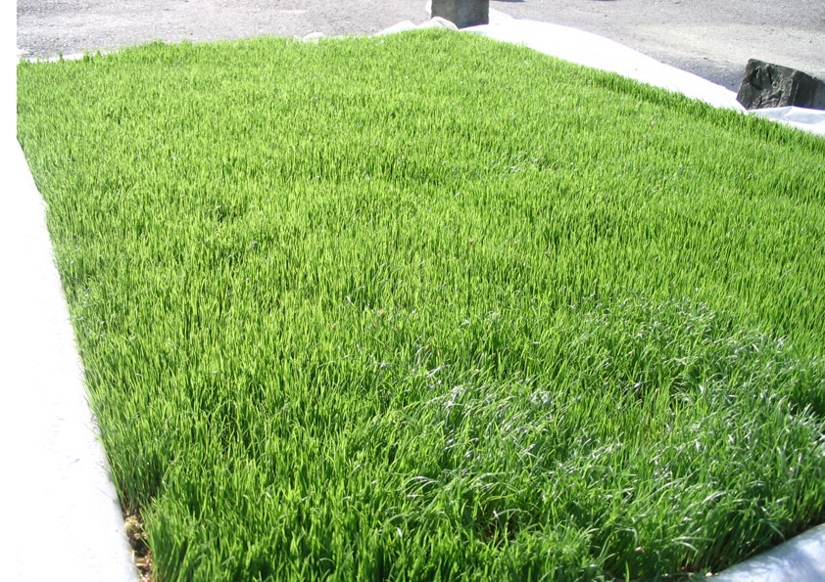
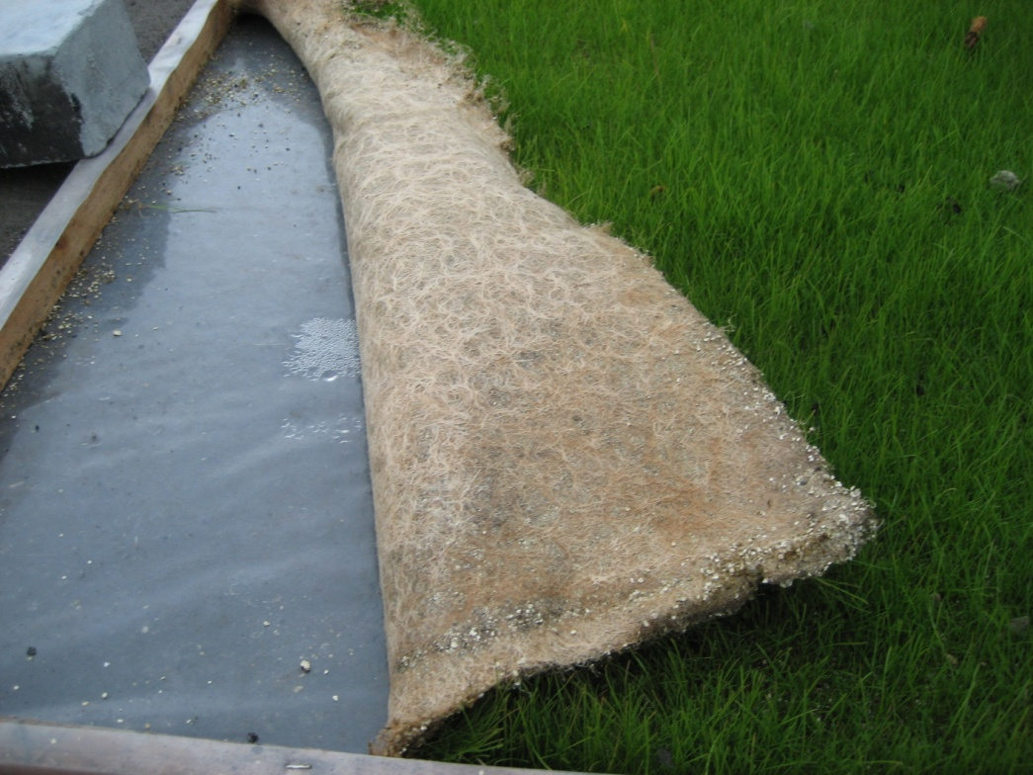
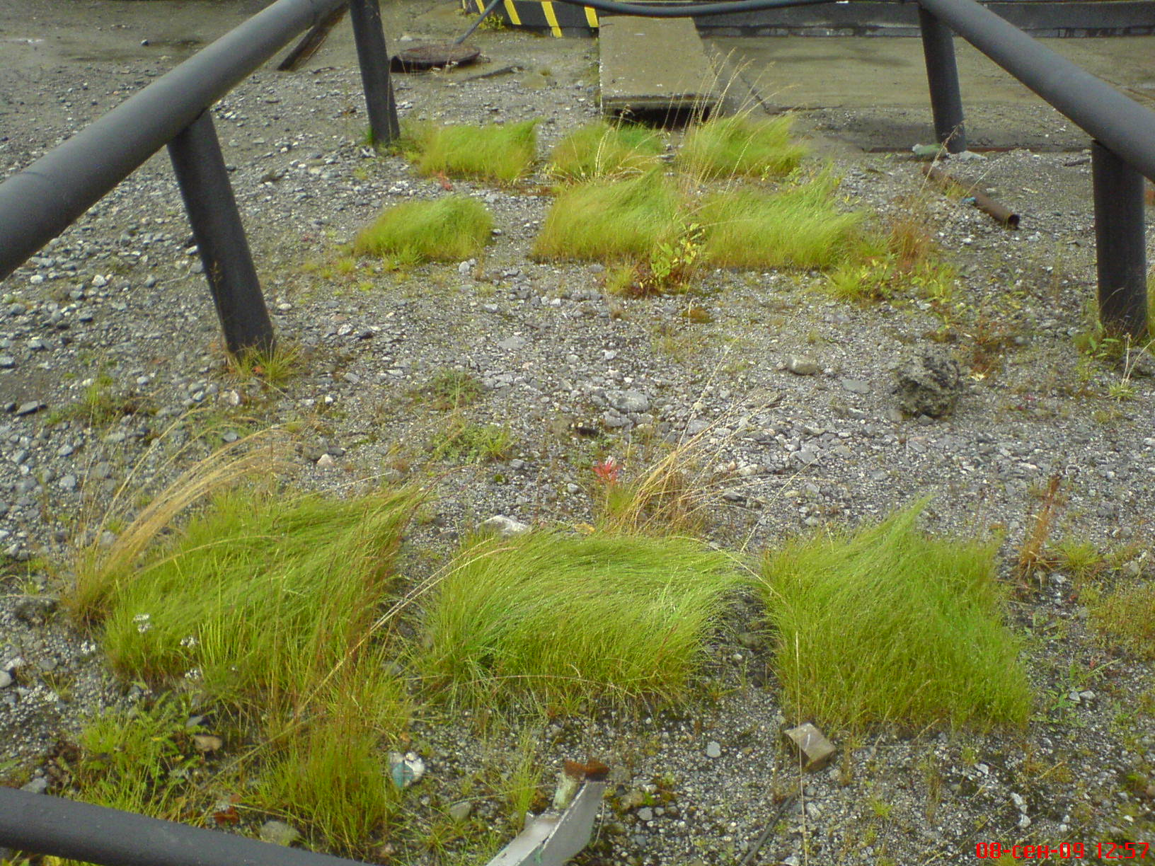

Slide 28
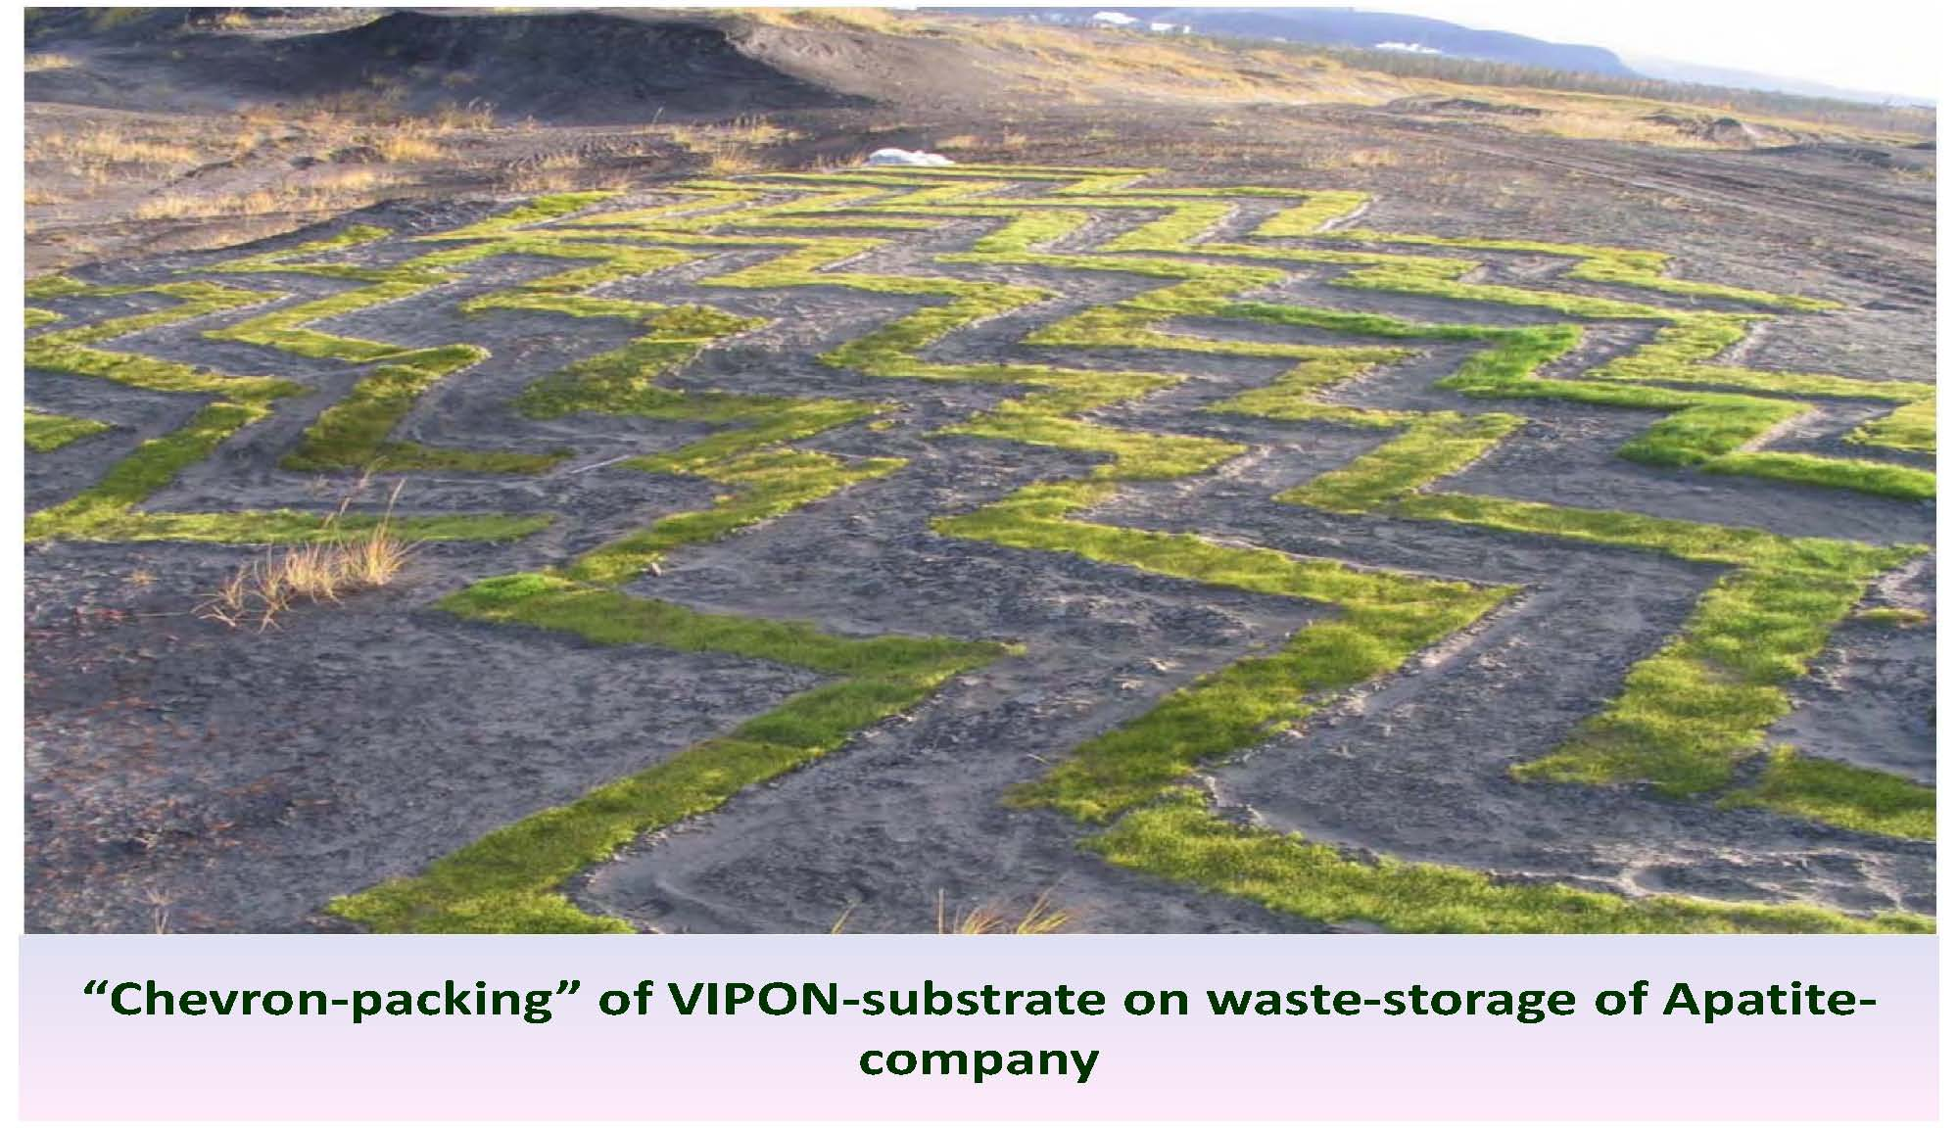

Slide 29
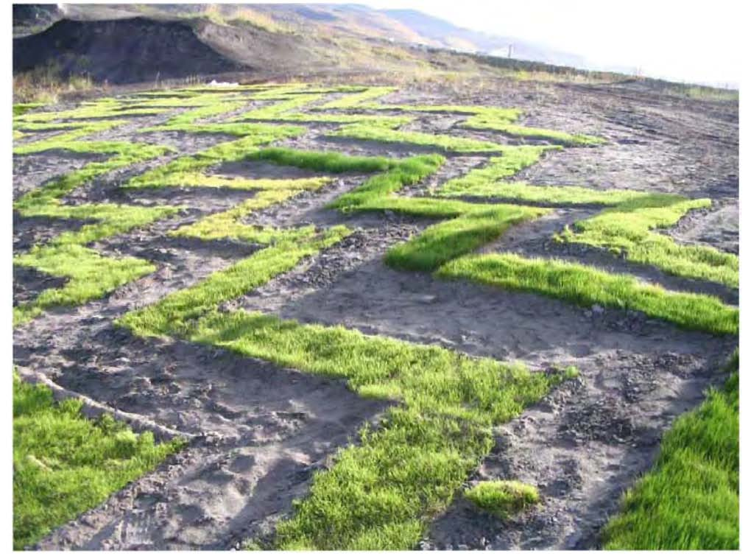

Slide 33
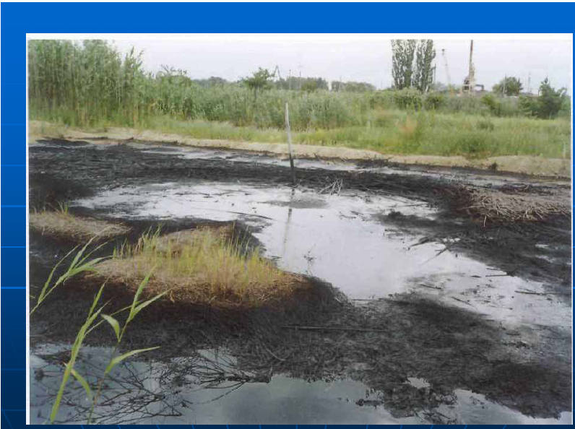
Soils bioremediation

Slide 37
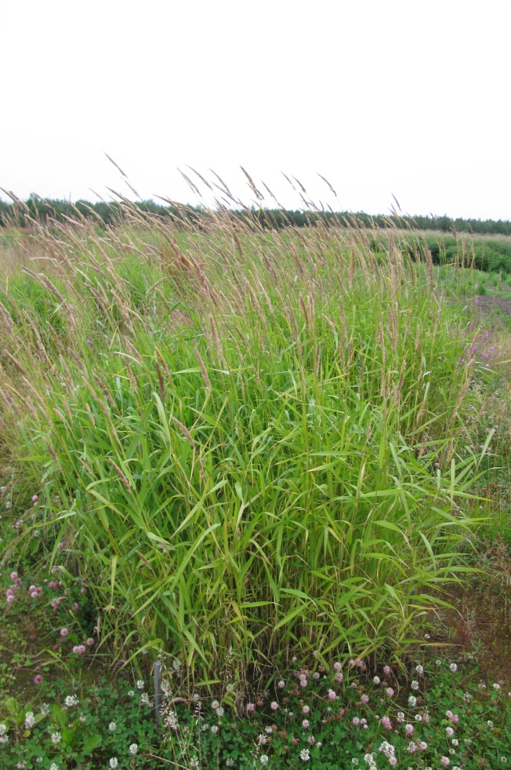
High resistance: - Phalaroides arundinacea (L.) Rauschert. - Festuca pratensis Нuds. - Phleum pratense L. - Leymus arenarius (L.) Hochst. - Bromopsis inermis (Leyss.) Holub. Medium resistance: - Lotus corniculatus L.s.l. - Galega orientalis Lam.
Plants, as highest eucariotic organisms, are more sensitive to oil hydrocarbons than microorganisms, possessing the function of degradation of many organic compounds. A species of plants has been selected for phytoremediation of soils polluted with oil products in the high latitudes.

Slide 38
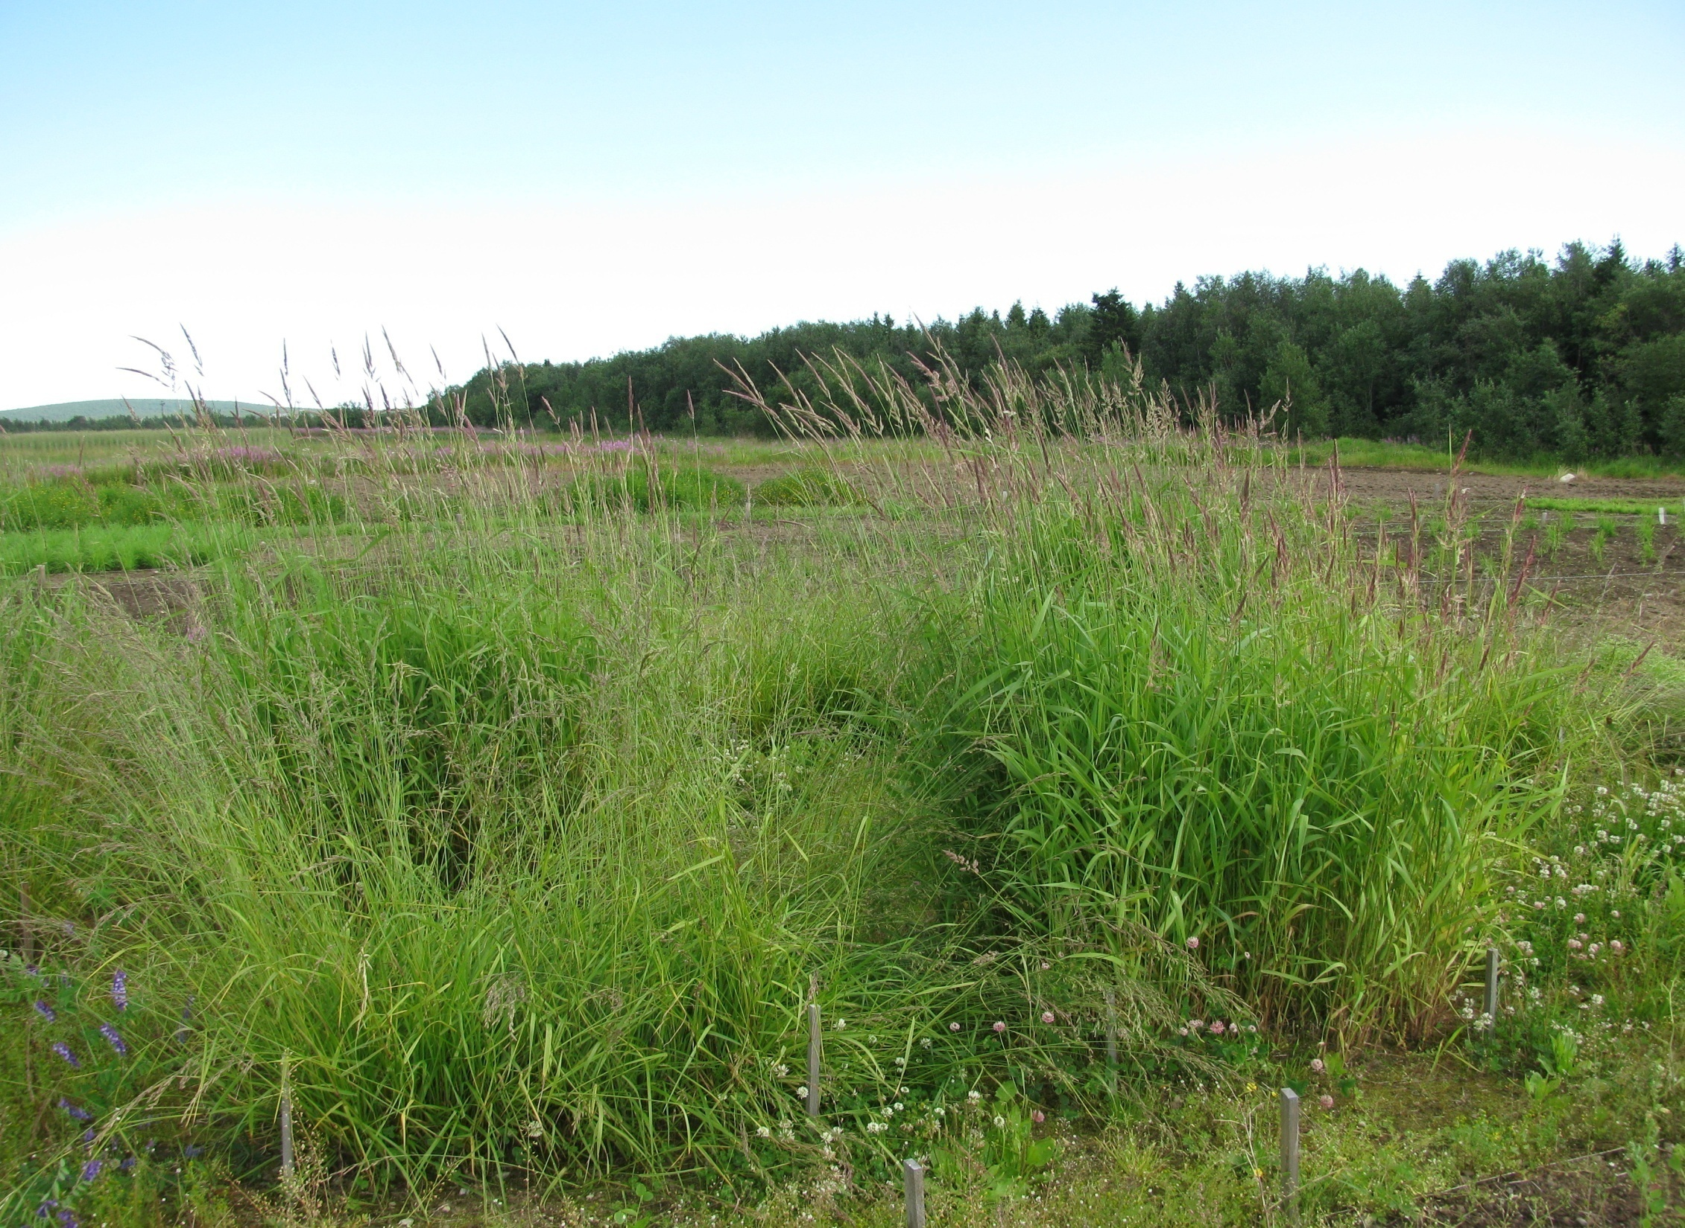
Двукисточник тростниковидный Painted grass (Digraphus arundinacea) on the oil contaminated soils under the field experiment condition

Slide 39
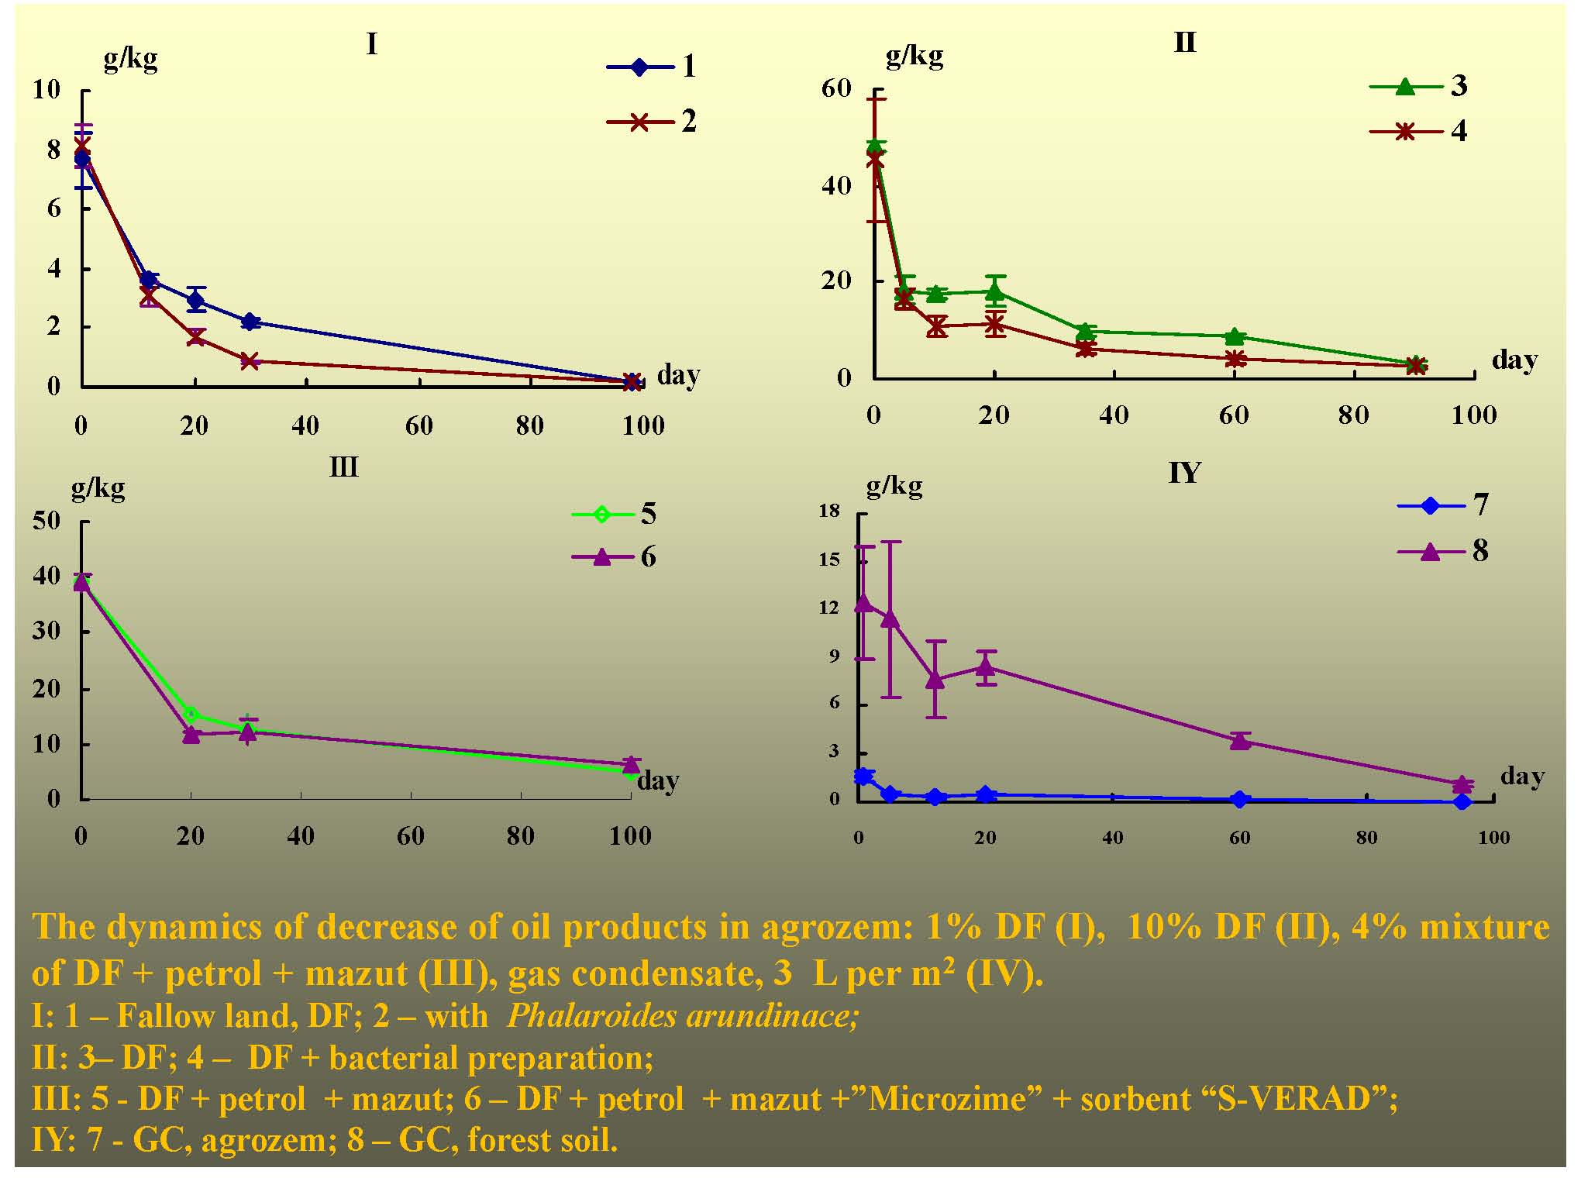
Main Task – to remediate soils during one vegetation period (90-100 days)

Slide 40
Integrated Climate Change Strategies for Sustainable Development of Russia’s Arctic Regions (Case Study for Murmansk oblast)
Notes:
40

Slide 41
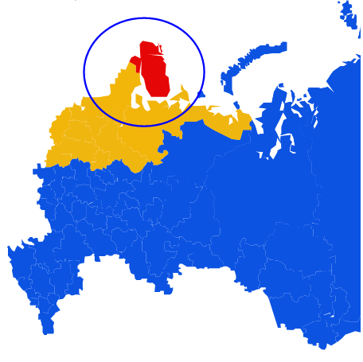
INTEGRATED CLIMATIC
STRATEGY FOR THE RUSSIAN
ARCTIC REGIONS
Elements of regional plans of social and economic development:
-- Mitigation of consequences of the climate change
-- Adaptation
-- Development of scientific and technical base and researches
-- Financing and Institutional mechanisms
Complex projects: decrease in emissions of greenhouse gases + decrease in climatic risks

Slide 42
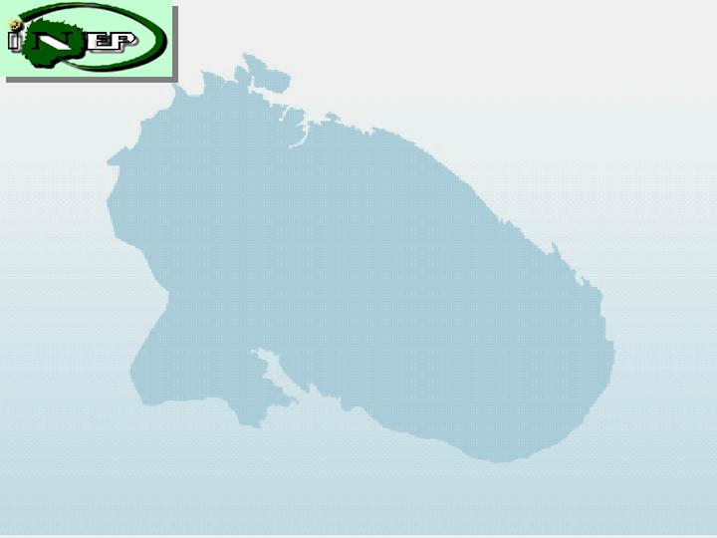
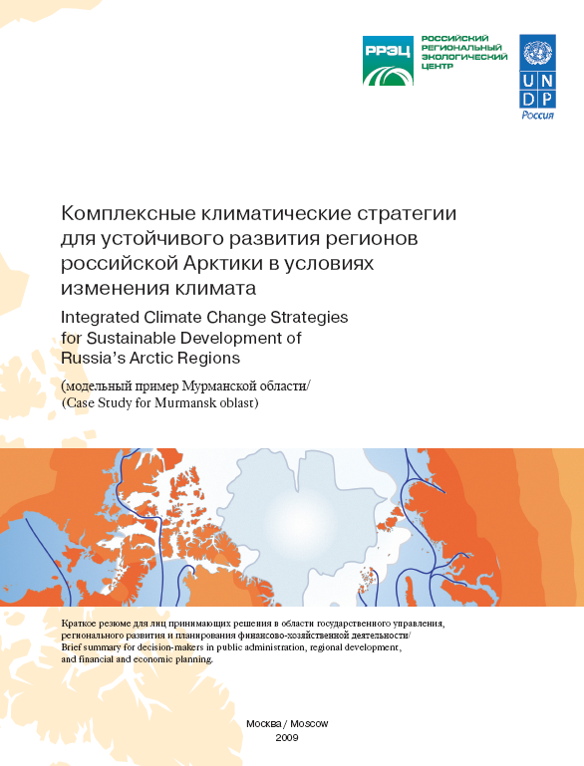
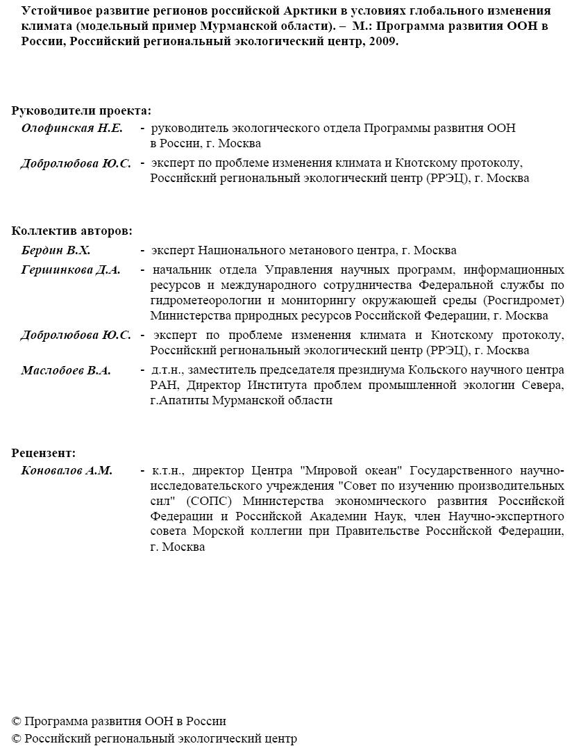
http://www.undp.ru/climatechange/

Slide 43
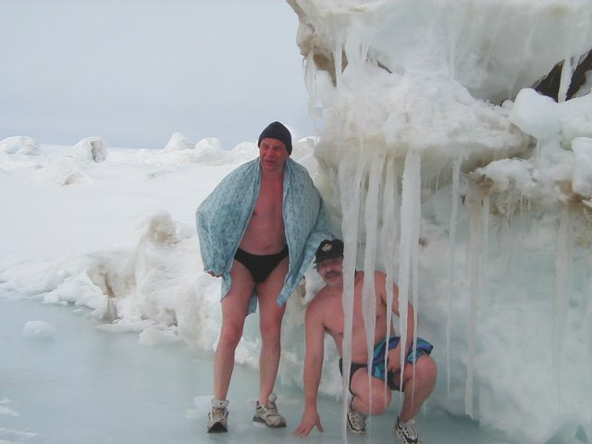
Climatic changes and their consequences for development of resources in Arctic
Data of International Polar Year 2007/08 confirm, that in the Arctic climatic system there is essential and fast warming

Slide 44
Adaptation to Climate Change = Transition to Low-Carbon Development
 | Activity Directions | Realization Potential for Murmansk Region
1 | Increasing of Energy Efficiency and Energy Saving | Very high
2 | Development of Wind Energetics | Very high
3 | Development of Hydropower Energy (small size stations) | Very high
4 | Development of Solar Energy | Limited
5 | Development of Geothermal Energy | Very low
6 | Development of Tidal Power Stations and Wave Energy | High
7 | Development of Bioenergetics | High
8 | Increase of the natural gas share in fuel balance | Very high
9 | Development of Nuclear Energetics | High
10 | Implimentation of technologies for СО₂ storage and capture | High, far future

Slide 45
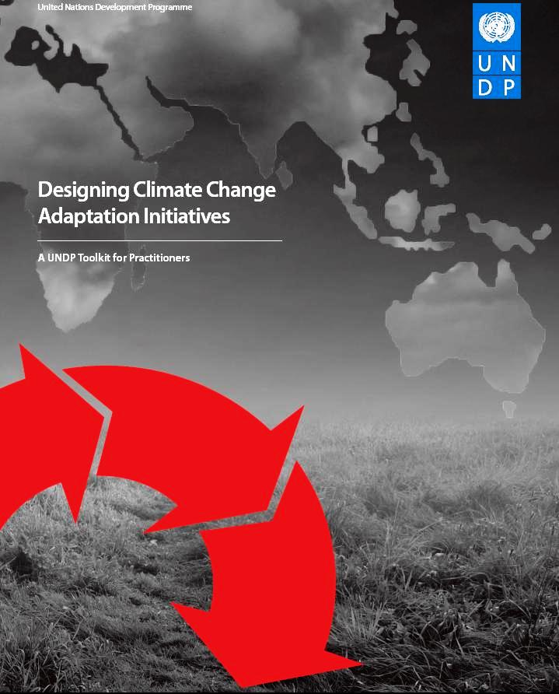
Measures on adaptation for Arctic regions and Murmansk oblast
Mining industry
Transport (especially sea)
Power production
Infrastructure
Coastal territories
Fishery
Rural and Forestry
Tourism
Ingenous people in the North
Extreme Situations
Population health
Health of Ecosystems

Slide 46
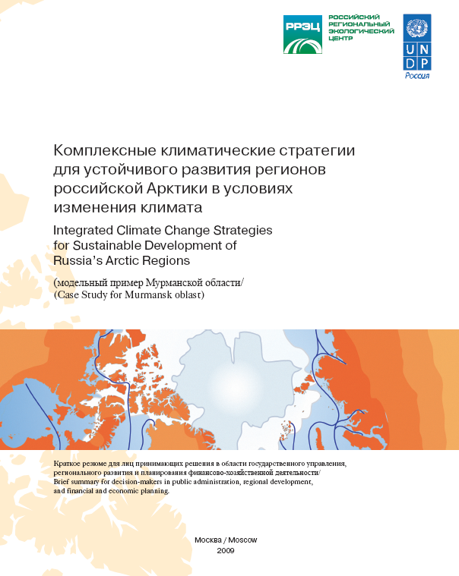
Summary
Challenges of Adaptation to Climate Change are Challenges of Society Development
Adaptation reduces risks. Inclusion of the information on climatic risks in development programs = «the insurance award».
Adaptation and Low-Corbon Development = Sustainable Development, and both are very favorable to Economics and to Society.
The Establishment of an Action Plan on Climate Change in Barents Region (Norwegian Initiative_2012)

Slide 47
CONCLUSION
Scientific and Technological Co-operation is Driving Force for Sustainable Development in the Arctic.
Which way it is possible to consolidate all scientific forces and modern technologies for Green Mining Industry in the Arctic? To create a partnerships Network between universities and research institutions, mining companies, etc. in the Barents-Arctic Region.

Slide 48
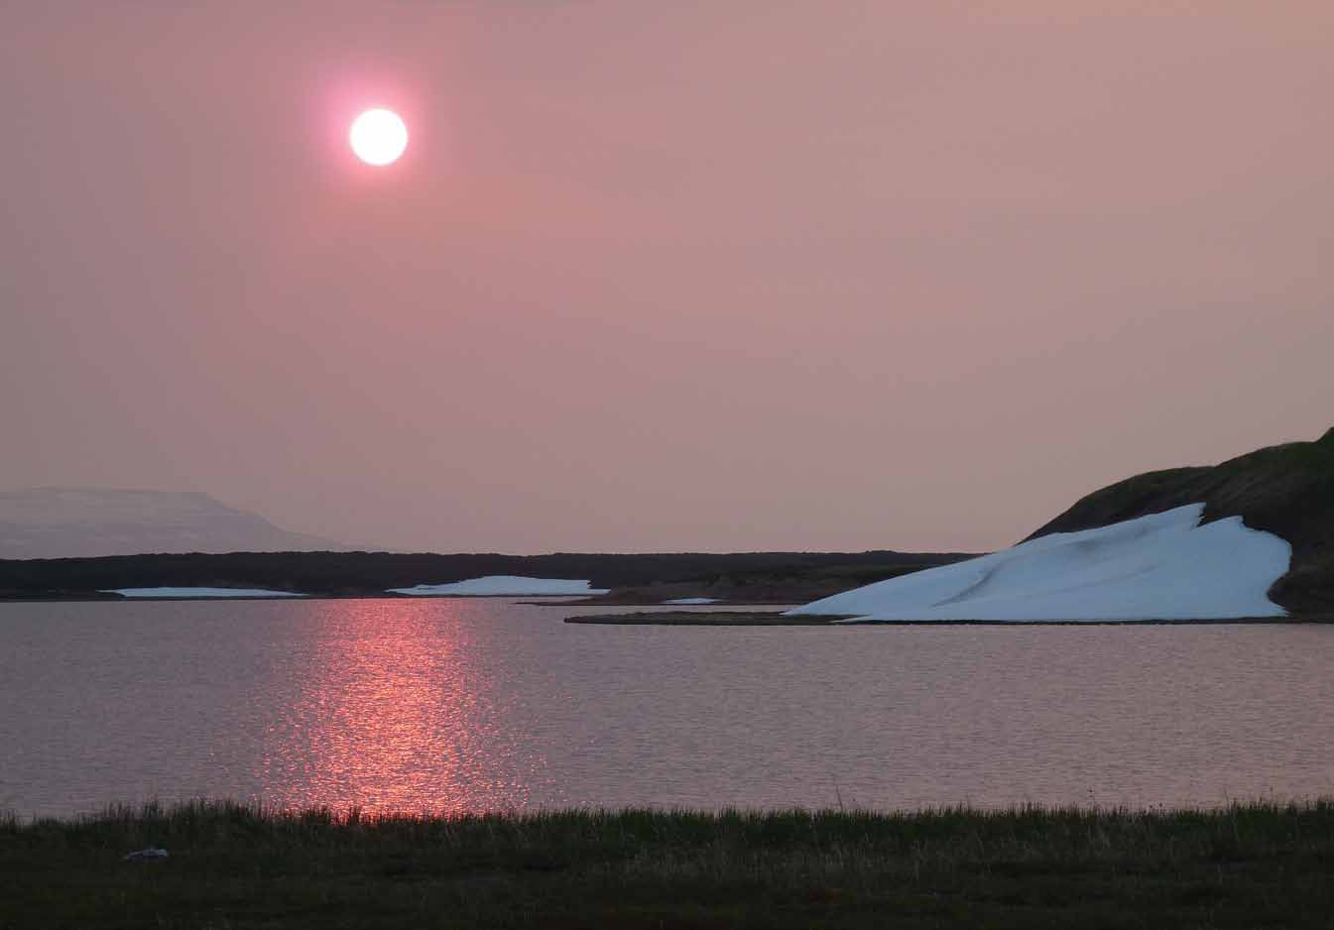
Благодарю за внимание! Thanks You very much for Your attention! Takk for oppmerksomheten! Kiitos mielenkiinnosta!

